Slide 1




AREA II:
LAND AND WATER RESOURCES ENGINEERING
ABELE | 2025
ATTRC - Iligan City

Slide 2
IRRIGATION AND DRAINAGE ENGINEERING
Surveying
Pumps
Fluid Mechanics
Open Channel
Groundwater Hydrology
Pressurized Irrigation Systems

Slide 3
IRRIGATION AND DRAINAGE ENGINEERING
Surveying
Pumps
Fluid Mechanics
Open Channel
Groundwater Hydrology
Pressurized Irrigation Systems

Slide 4
Surveying
Pumps
GROUNDWATER HYDROLOGY
Fluid Mechanics
Open Channel
Pressurized Irrigation Systems

Slide 5
QUESTION 1
This refers to the water that exists underground in saturated zones beneath the land surface.
Freshwater
Groundwater
Aquifer
Surface water
Reference: https://www.usgs.gov/faqs/what-groundwater
ATTRC ABELE Review 2025
Irrigation and Drainage Engineering | Groundwater Hydrology

Slide 6
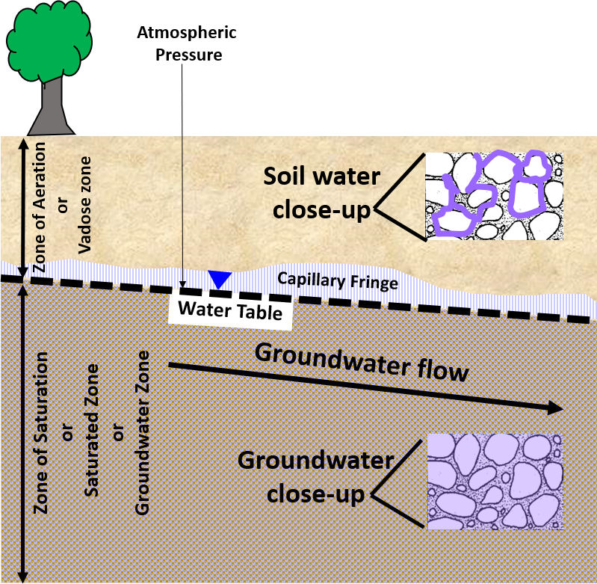
Groundwater is water that occurs below the ground surface in zones of porous materials where all the cracks (fractures) and pore spaces are filled with water and that water is at a pressure higher than the pressure of the atmosphere (Figure 1). This region or zone is referred to as the zone of saturation, saturated zone, zone of phreatic water, or groundwater zone.
Reference: https://books.gw-project.org/hydrogeologic-properties-of-earth-materials-and-principles-of-groundwater-flow/part/defining-groundwater/
ATTRTC ABELE Review 2024
ATTRC ABELE Review 2025
Irrigation and Drainage Engineering | Groundwater Hydrology
Irrigation and Drainage Engineering | Groundwater Hydrology

Slide 7
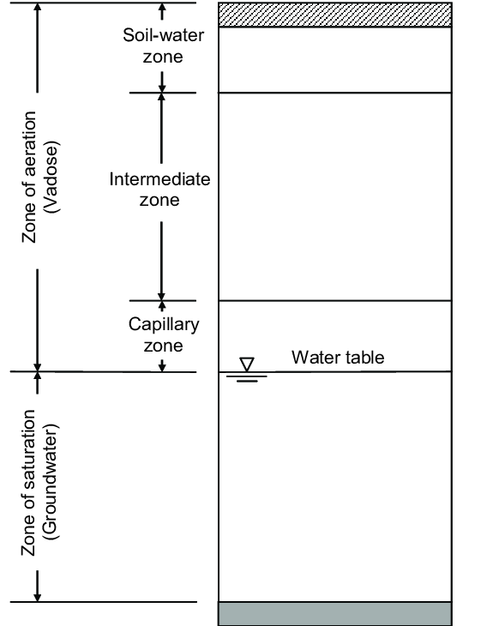
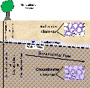
The capillary fringe is a zone of soil just above the water table where water is drawn upwards due to capillary action, effectively saturating the pore spaces. This upward movement is caused by the adhesive and cohesive forces between water and soil particles, as well as the surface tension of water. The capillary fringe is a transition zone between the unsaturated zone above and the saturated groundwater zone below.
Reference: https://books.gw-project.org/hydrogeologic-properties-of-earth-materials-and-principles-of-groundwater-flow/part/defining-groundwater/
ATTRTC ABELE Review 2024
ATTRC ABELE Review 2025
Irrigation and Drainage Engineering | Groundwater Hydrology
Irrigation and Drainage Engineering | Groundwater Hydrology

Slide 8
QUESTION 2
What percentage of the global freshwater reserves is groundwater?
0.3%
3%
30%
69%
Reference: https://www.usgs.gov/special-topics/water-science-school/science/where-earths-water
ATTRTC ABELE Review 2024
ATTRC ABELE Review 2025
Irrigation and Drainage Engineering | Groundwater Hydrology
Irrigation and Drainage Engineering | Groundwater Hydrology

Slide 9
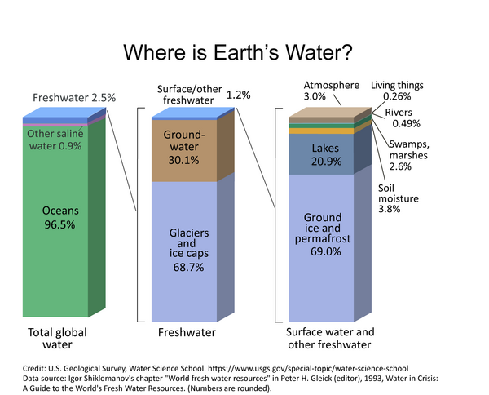
Reference: https://www.usgs.gov/special-topics/water-science-school/science/where-earths-water
ATTRTC ABELE Review 2024
ATTRC ABELE Review 2025
Irrigation and Drainage Engineering | Groundwater Hydrology
Irrigation and Drainage Engineering | Groundwater Hydrology

Slide 10
QUESTION 3
The following are applications of groundwater in ABE, except?
Irrigation for crops
Recharging aquifers to ensure long-term water availability
Wastewater treatment through natural filtration processes
Generating renewable energy through hydroelectric power
Reference: https://chem.libretexts.org/Courses/University_of_Arkansas_Little_Rock/Chem_1402%3A_General_Chemistry_1_(Kattoum)
ATTRTC ABELE Review 2024
ATTRC ABELE Review 2025
Irrigation and Drainage Engineering | Groundwater Hydrology
Irrigation and Drainage Engineering | Groundwater Hydrology

Slide 11
QUESTION 4
This property is a measure of how easily water can pass through soil or rock, wherein high values indicate permeable material through which water can pass easily while low values indicate that the material is less permeable. It also has the same units as velocity.
Porosity
Transmissivity
Infiltration rate
Hydraulic conductivity
Reference: https://chem.libretexts.org/Courses/University_of_Arkansas_Little_Rock/Chem_1402%3A_General_Chemistry_1_(Kattoum)
ATTRTC ABELE Review 2024
ATTRC ABELE Review 2025
Irrigation and Drainage Engineering | Groundwater Hydrology
Irrigation and Drainage Engineering | Groundwater Hydrology

Slide 12
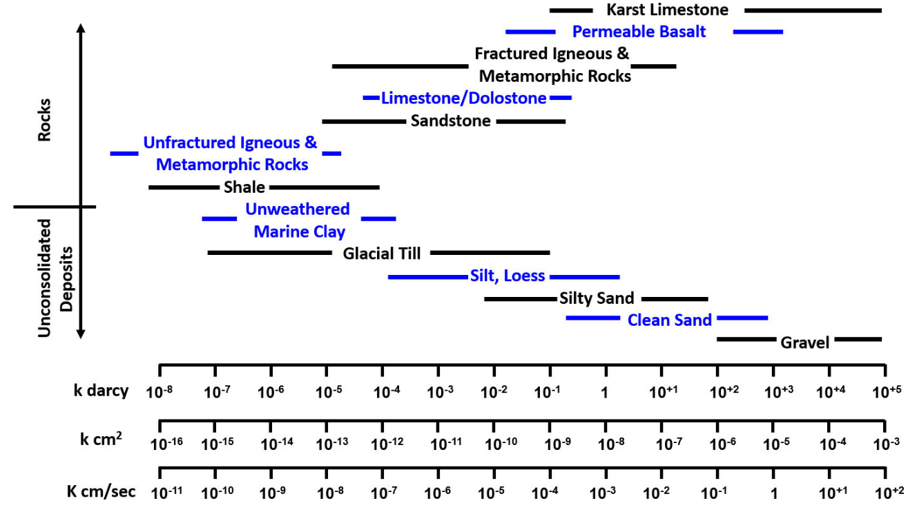
Reference: https://books.gw-project.org/hydrogeologic-properties-of-earth-materials-and-principles-of-groundwater-flow/chapter/hydraulic-conductivity-values-for-earth-materials/
ATTRTC ABELE Review 2024
ATTRC ABELE Review 2025
Irrigation and Drainage Engineering | Groundwater Hydrology
Irrigation and Drainage Engineering | Groundwater Hydrology

Slide 13
Reference: https://books.gw-project.org/hydrogeologic-properties-of-earth-materials-and-principles-of-groundwater-flow/chapter/hydraulic-conductivity-values-for-earth-materials/
ATTRTC ABELE Review 2024
ATTRC ABELE Review 2025
Irrigation and Drainage Engineering | Groundwater Hydrology
Irrigation and Drainage Engineering | Groundwater Hydrology

Slide 14
Important Terminologies
Hydraulic head - elevation of the water level in the piezometers
Hydraulic gradient - difference in the hydraulic head over a distance along the flow path. It also refers to the locus of elevations to which water will rise in the Piezometer tube.
Hydraulic conductivity - the relative ease of fluid passage through a porous material
Drawdown - localized lowering of the static or piezometric water level due to pumping
ATTRTC ABELE Review 2024
ATTRC ABELE Review 2025
Irrigation and Drainage Engineering | Groundwater Hydrology
Irrigation and Drainage Engineering | Groundwater Hydrology

Slide 15
QUESTION 5
What does a piezometer do?
Piezometers are instruments used to measure pore water pressure, which is the pressure of water within the voids of soil or rock.
Piezometers are used to determine the chemical composition of groundwater.
Piezometers are designed to monitor subsurface temperature variations in soil or rock layers to study geothermal gradients and thermal conductivity.
Piezometers are tools designed to extract soil samples from deep underground.
Reference: https://books.gw-project.org/hydrogeologic-properties-of-earth-materials-and-principles-of-groundwater-flow/chapter/properties-of-aquifers-and-confining-units/)
ATTRTC ABELE Review 2024
ATTRC ABELE Review 2025
Irrigation and Drainage Engineering | Groundwater Hydrology
Irrigation and Drainage Engineering | Groundwater Hydrology

Slide 16
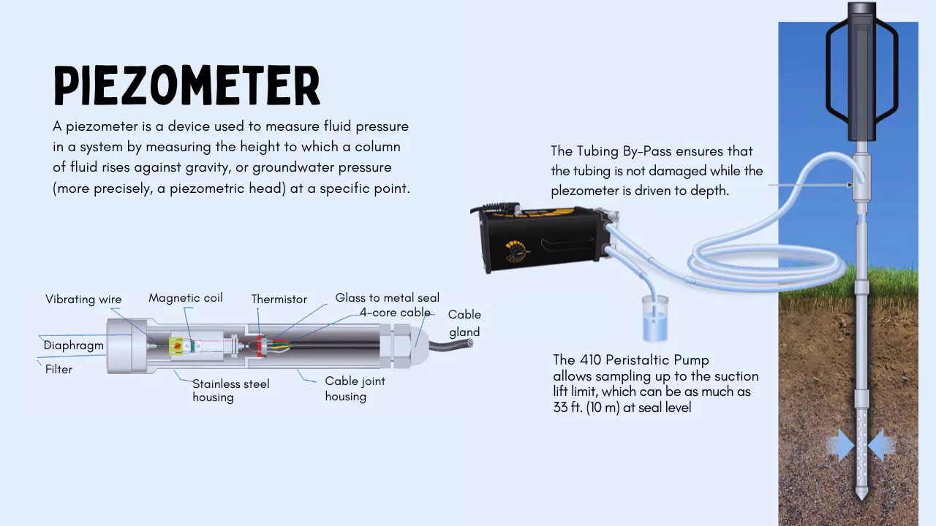
ATTRTC ABELE Review 2024
ATTRC ABELE Review 2025
Irrigation and Drainage Engineering | Groundwater Hydrology
Irrigation and Drainage Engineering | Groundwater Hydrology

Slide 17
QUESTION 6
Which of the following best differentiate hydraulic conductivity and transmissivity?
Hydraulic conductivity refers to the movement of water through soil, while transmissivity measures the rate at which water is transmitted horizontally through an entire aquifer thickness.
Hydraulic conductivity measures the ease of water flow in unsaturated soils, while transmissivity is the vertical movement of water in saturated zones.
Hydraulic conductivity represents the water-holding capacity of soil, and transmissivity measures the volume of water retained in the aquifer.
Hydraulic conductivity measures how deep water can penetrate the soil, and transmissivity refers to the water table's fluctuation in an aquifer.
Reference: https://books.gw-project.org/hydrogeologic-properties-of-earth-materials-and-principles-of-groundwater-flow/chapter/properties-of-aquifers-and-confining-units/)
ATTRTC ABELE Review 2024
ATTRC ABELE Review 2025
Irrigation and Drainage Engineering | Groundwater Hydrology
Irrigation and Drainage Engineering | Groundwater Hydrology

Slide 18
QUESTION 7
The arrangement of the four geologic formations based on decreasing economic considerations.
Aquifer - Aquiclude - Aquitard - Aquifuge
Aquifer - Aquitard - Aquiclude - Aquifuge
Aquifer – Aquifuge - Aquiclude - Aquitard
Aquiclude - Aquifer - Aquitard - Aquifuge
Reference: https://books.gw-project.org/hydrogeologic-properties-of-earth-materials-and-principles-of-groundwater-flow/chapter/properties-of-aquifers-and-confining-units/)
ATTRTC ABELE Review 2024
ATTRC ABELE Review 2025
Irrigation and Drainage Engineering | Groundwater Hydrology
Irrigation and Drainage Engineering | Groundwater Hydrology

Slide 19
Aquifer - A water bearing geologic formation or stratum capable of transmitting water through its pores at a rate sufficient for economic extraction by wells. The ease transmission of water in due to its high permeability. Formations of good aquifers have unconsolidated sand and gravel.
Aquiclude - A geologic formation, which can absorb water but cannot transmit significant amounts. Clay formations are example of an aquiclude.
Aquitard - A geologic formation of rather impervious nature, which transmits water at a slow rate compared to an aquifer (insufficient for pumping from wells) Aquitard formations are sandy clay.
Aquifuge - A geologic formation with no interconnected pores and hence can neither absorb nor transmit water. These are formations made of massive compact rocks without any fractures.
Reference: https://books.gw-project.org/hydrogeologic-properties-of-earth-materials-and-principles-of-groundwater-flow/chapter/properties-of-aquifers-and-confining-units/)
ATTRTC ABELE Review 2024
ATTRC ABELE Review 2025
Irrigation and Drainage Engineering | Groundwater Hydrology
Irrigation and Drainage Engineering | Groundwater Hydrology

Slide 20
QUESTION 8
What are the two classifications of an aquifer?
Open and closed
Confined and unconfined
Flowing and Non-flowing
Perched and unperched
Reference: https://books.gw-project.org/hydrogeologic-properties-of-earth-materials-and-principles-of-groundwater-flow/chapter/properties-of-aquifers-and-confining-units/)
ATTRTC ABELE Review 2024
ATTRC ABELE Review 2025
Irrigation and Drainage Engineering | Groundwater Hydrology
Irrigation and Drainage Engineering | Groundwater Hydrology

Slide 21
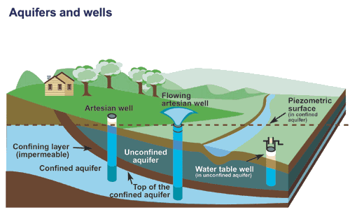
Confined aquifer - aquifer below the land surface that is saturated with water.
Flowing artesian well
Non-flowing artesian well
Unconfined aquifer - an aquifer whose upper water surface (water table) is at atmospheric pressure, and thus is able to rise and fall.
Water table well
Perched Aquifer
Reference: https://www.usgs.gov/special-topics/water-science-school/science/aquifers-and-groundwater
ATTRTC ABELE Review 2024
ATTRC ABELE Review 2025
Irrigation and Drainage Engineering | Groundwater Hydrology
Irrigation and Drainage Engineering | Groundwater Hydrology

Slide 22

RELATED EQUATIONS
1. Specific Yield
Sy = $\frac{{\text{w}}_{\text{y}}}{{\text{V}}_{\text{T}}}$
2. Specific Retention
Sr = $\frac{{\text{w}}_{\text{r}}}{{\text{V}}_{\text{T}}}$
3. Change in Groundwater Storage
$\text{∆}\text{GWS}\text{ = }{\text{A}}_{\text{aq}} \text{x} \text{∆}\text{GWT} \text{x} {\text{S}}_{\text{y}}$ (for unconfined aquifer)
$\text{∆}\text{GWS}\text{ = }{\text{A}}_{\text{aq}} \text{x} \text{ps} \text{x} \text{S}$ (for confined aquifer)
Where: $\text{∆}\text{GWS}$ – change in groundwater storage, m3
                Aaq – area of the aquifer, m2
                $\text{∆}\text{GWT}$ – groundwater table fluctuation or drawdown, m
                Ps – piezometric surface fluctuation
                Sy – specific yield
                S – storage coefficient
Porosity, n = Sy + Sr
ATTRTC ABELE Review 2024
ATTRC ABELE Review 2025
Irrigation and Drainage Engineering | Groundwater Hydrology
Irrigation and Drainage Engineering | Groundwater Hydrology

Slide 23

QUESTION 9
Estimate the average groundwater drawdown across an area of 100 km², where 20 million cubic meters of water have been pumped from a series of uniformly distributed wells. The specific yield of the unconfined aquifer is 20%.
Ans.: 1m
$\text{∆}\text{GWS}\text{ = }{\text{A}}_{\text{aq}} \text{x} \text{∆}\text{GWT} \text{x} {\text{S}}_{\text{y}}$ (for unconfined aquifer)
$\text{∆}\text{GWS}\text{ = }{\text{A}}_{\text{aq}} \text{x} \text{ps} \text{x} \text{S}$ (for confined aquifer)
Where: $\text{∆}\text{GWS}$ – change in groundwater storage, m3
                Aaq – area of the aquifer, m2
                $\text{∆}\text{GWT}$ – groundwater table fluctuation or drawdown, m
                Ps – piezometric surface fluctuation
                Sy – specific yield
                S – storage coefficient
ATTRTC ABELE Review 2024
ATTRC ABELE Review 2025
Irrigation and Drainage Engineering | Groundwater Hydrology
Irrigation and Drainage Engineering | Groundwater Hydrology
Notes:
GWS/A x Sy
$\text{∆}\text{GWS}$ – change in groundwater storage, m3
Aaq – area of the aquifer, m2
$\text{∆}\text{GWT}$ – groundwater table fluctuation or drawdown, m
Ps – piezometric surface fluctuation
Sy – specific yield
S – storage coefficient

Slide 24
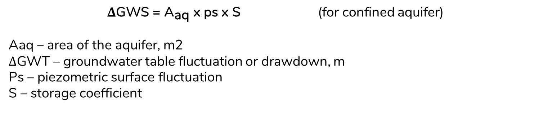
QUESTION 10
Calculate the volume of water released from a confined aquifer when the piezometric surface is lowered by 6.5 meters over an area of 2 km². The aquifer is 30 meters thick, with a storage coefficient of 8.1 x 10⁻³.
Ans. 105,300m3
$\text{∆}\text{GWS}\text{ = }{\text{A}}_{\text{aq}} \text{x} \text{ps} \text{x} \text{S}$ (for confined aquifer)
                Aaq – area of the aquifer, m2
                $\text{∆}\text{GWT}$ – groundwater table fluctuation or drawdown, m
                Ps – piezometric surface fluctuation
                S – storage coefficient
ATTRTC ABELE Review 2024
ATTRC ABELE Review 2025
Irrigation and Drainage Engineering | Groundwater Hydrology
Irrigation and Drainage Engineering | Groundwater Hydrology
Notes:
$\text{∆}\text{GWS}$ – change in groundwater storage, m3
Aaq – area of the aquifer, m2
$\text{∆}\text{GWT}$ – groundwater table fluctuation or drawdown, m
Ps – piezometric surface fluctuation
S – storage coefficient

Slide 25
QUESTION 11
Darcy equation is used only to what type of flow?
Laminar
Quasi-steady
Steady
Turbulent
Reference: https://chem.libretexts.org/Courses/University_of_Arkansas_Little_Rock/Chem_1402%3A_General_Chemistry_1_(Kattoum)
ATTRTC ABELE Review 2024
ATTRC ABELE Review 2025
Irrigation and Drainage Engineering | Groundwater Hydrology
Irrigation and Drainage Engineering | Groundwater Hydrology

Slide 26
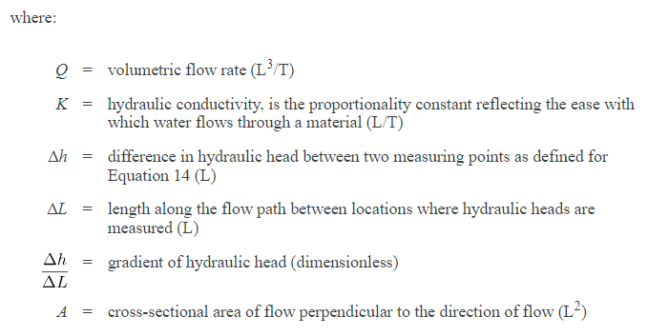

RECALL
Darcy’s Law shows the mathematical relationship that indicated the steady-state flow rate through the circular sand filter. Darcy found that the flow rate was also directly proportional to the hydraulic conductivity or permeability.
Darcy Equation - basic form of energy loss in the flow equation. It states that the energy loss is directly proportional to the some friction factor, the length of the system and the kinetic energy level and inversely proportional to the diameter of the conductor.
ATTRTC ABELE Review 2024
ATTRC ABELE Review 2025
Irrigation and Drainage Engineering | Groundwater Hydrology
Irrigation and Drainage Engineering | Groundwater Hydrology

Slide 27
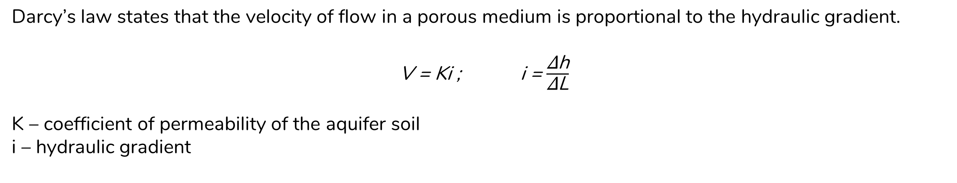
RECALL
Equation for velocity
Darcy’s law states that the velocity of flow in a porous medium is proportional to the hydraulic gradient.
V = Ki ; i = $\frac{\text{∆}\text{h}}{\text{∆}\text{L}}$
K – coefficient of permeability of the aquifer soil
i – hydraulic gradient
V_{actual} = $\frac{\text{V}}{\text{n}}$
ATTRTC ABELE Review 2024
ATTRC ABELE Review 2025
Irrigation and Drainage Engineering | Groundwater Hydrology
Irrigation and Drainage Engineering | Groundwater Hydrology

Slide 28
QUESTION 11
Which property describes the flow capacity of an aquifer per unit width under unit hydraulic gradient, and is equal to the product of permeability multiplied by the saturated thickness of the aquifer?
Transmissivity
Conductivity
Permeability
Transitionability
Transmissivity is given by:
T = Kb (for confined aquifer)
T = KH (for unconfined aquifer)
Where: k – permeability
b – thickness of the confined aquifer
H – height of static water level above the bottom of water bearing formation
Reference: https://chem.libretexts.org/Courses/University_of_Arkansas_Little_Rock/Chem_1402%3A_General_Chemistry_1_(Kattoum)
ATTRTC ABELE Review 2024
ATTRC ABELE Review 2025
Irrigation and Drainage Engineering | Groundwater Hydrology
Irrigation and Drainage Engineering | Groundwater Hydrology

Slide 29
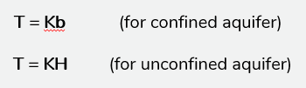

Important Formulas in Well Hydraulics
Formula for water yield (Q) given drawdown in two observation wells
Q = $\frac{πK(h_{2}^{2}−h_{1}^{2})}{ln\left(\frac{r_{2}}{r_{1}}\right)}$
Formula for water yield (Q), assuming very small drawdowns
Q = $\frac{2πT(H−hw)}{ln\left(\frac{R}{r_{w}}\right)}$
For confined aquifer: Q = $\frac{2πKb(H−hw)}{ln\left(\frac{R}{r_{w}}\right)}$ For unconfined aquifer: Q = $\frac{2πKH(H−hw)}{ln\left(\frac{R}{r_{w}}\right)}$
Where: k: permeability
b: thickness of the confined aquifer
H: height of static water level above the bottom of water bearing formation
s: drawdown in observation well
h: H – s
r: center-to-center distance of well to observation wells
Where: R: radius of influence
r: radius of the well
Reference: https://chem.libretexts.org/Courses/University_of_Arkansas_Little_Rock/Chem_1402%3A_General_Chemistry_1_(Kattoum)
ATTRTC ABELE Review 2024
ATTRC ABELE Review 2025
Irrigation and Drainage Engineering | Groundwater Hydrology
Irrigation and Drainage Engineering | Groundwater Hydrology

Slide 30
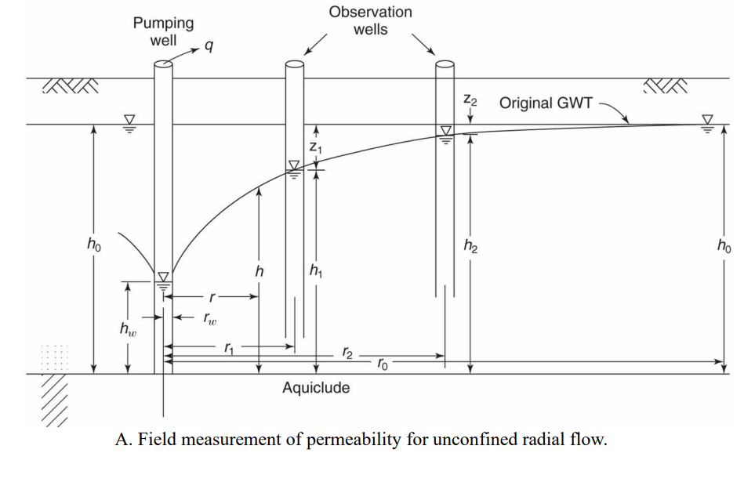
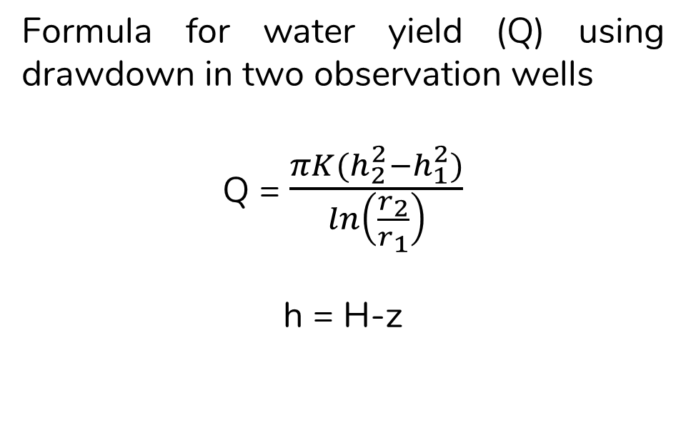
Formula for water yield (Q) using drawdown in two observation wells
Q = $\frac{πK(h_{2}^{2}−h_{1}^{2})}{ln\left(\frac{r_{2}}{r_{1}}\right)}$
h = H-z
ATTRTC ABELE Review 2024
ATTRC ABELE Review 2025
Irrigation and Drainage Engineering | Groundwater Hydrology
Irrigation and Drainage Engineering | Groundwater Hydrology

Slide 31
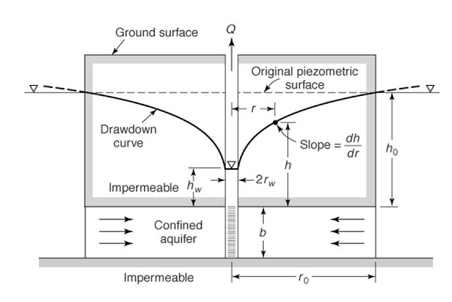

Formula for water yield (Q), single well
Q = $\frac{2πT(H−hw)}{ln\left(\frac{r_{2}}{r_{1}}\right)}$
For confined aquifer:
Q = $\frac{2πKb(H−hw)}{ln\left(\frac{R}{r_{w}}\right)}$
For unconfined aquifer:
Q = $\frac{2πKH(H−hw)}{ln\left(\frac{R}{r_{w}}\right)}$
drawdown (sw) = H - hw
ATTRTC ABELE Review 2024
ATTRC ABELE Review 2025
Irrigation and Drainage Engineering | Groundwater Hydrology
Irrigation and Drainage Engineering | Groundwater Hydrology

Slide 32
QUESTION 12
Which of the following best defines what ‘radius of influence’ is?
Minimum distance from the center of the lone pumped well wherein no drawdown will be observed.
The distance from the well where water flow velocity is the highest during pumping.
Average distance from the water table to the bottom of the well during pumping.
The depth of the well from which the water is being pumped.
ATTRTC ABELE Review 2024
ATTRC ABELE Review 2025
Irrigation and Drainage Engineering | Groundwater Hydrology
Irrigation and Drainage Engineering | Groundwater Hydrology

Slide 33
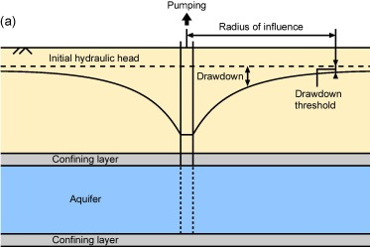
Radius of Influence
Minimum distance from the center of the lone pumped well wherein no drawdown will be observe.
Reference: https://www.sciencedirect.com/science/article/pii/S0022169420301062
ATTRTC ABELE Review 2024
ATTRC ABELE Review 2025
Irrigation and Drainage Engineering | Groundwater Hydrology
Irrigation and Drainage Engineering | Groundwater Hydrology

Slide 34
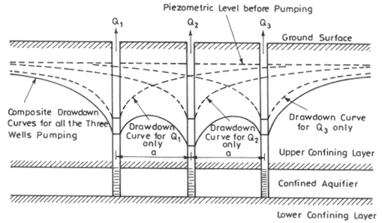
QUESTION 13
What occurs when the cones of depression of two or more nearby pumping wells overlap?
Drawdown
Groundwater decline
Well interference
Drawdown curve
Reference: http://ecoursesonline.iasri.res.in/mod/page/view.php?id=1838
ATTRTC ABELE Review 2024
ATTRC ABELE Review 2025
Irrigation and Drainage Engineering | Groundwater Hydrology
Irrigation and Drainage Engineering | Groundwater Hydrology

Slide 35
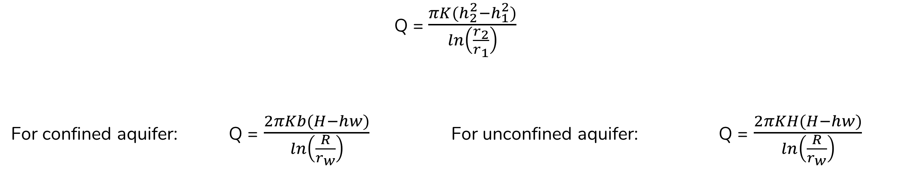
QUESTION 14
A 16-ft thick confined aquifer with hydraulic conductivity of 500ft/day was tapped by a 4” diameter shallow tubewell. With a radius of influence of 2000 ft, determine the maximum discharge of the STW in liters per second. Assume an allowable drawdown of 10ft.
Ans. 17.55lps
Q = $\frac{πK(h_{2}^{2}−h_{1}^{2})}{ln\left(\frac{r_{2}}{r_{1}}\right)}$
For confined aquifer: Q = $\frac{2πKb(H−hw)}{ln\left(\frac{R}{r_{w}}\right)}$ For unconfined aquifer: Q = $\frac{2πKH(H−hw)}{ln\left(\frac{R}{r_{w}}\right)}$
Reference: https://chem.libretexts.org/Courses/University_of_Arkansas_Little_Rock/Chem_1402%3A_General_Chemistry_1_(Kattoum)
ATTRTC ABELE Review 2024
ATTRC ABELE Review 2025
Irrigation and Drainage Engineering | Groundwater Hydrology
Irrigation and Drainage Engineering | Groundwater Hydrology

Slide 36
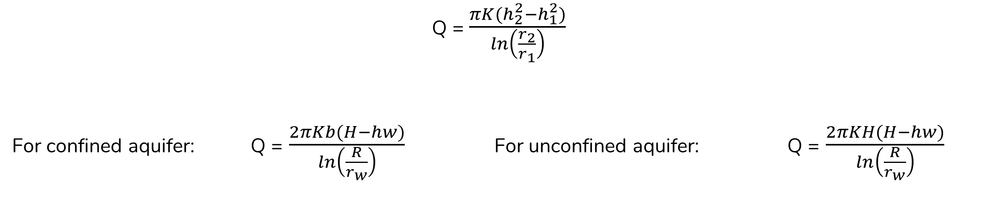
QUESTION 15
A 20-cm well penetrates 30-m below static water level (ground water table level). After a long period of pumping at a rate of 1800 Ipm, the drawdowns in the observation wells at 12m and 36 m from the pumped well are 1.2m and 0.5m, respectively. Calculate the transmissibility of the aquifer.
Ans.: 666.3m²/day
Q = $\frac{πK(h_{2}^{2}−h_{1}^{2})}{ln\left(\frac{r_{2}}{r_{1}}\right)}$
For confined aquifer: Q = $\frac{2πKb(H−hw)}{ln\left(\frac{R}{r_{w}}\right)}$ For unconfined aquifer: Q = $\frac{2πKH(H−hw)}{ln\left(\frac{R}{r_{w}}\right)}$
Reference: https://chem.libretexts.org/Courses/University_of_Arkansas_Little_Rock/Chem_1402%3A_General_Chemistry_1_(Kattoum)
ATTRTC ABELE Review 2024
ATTRC ABELE Review 2025
Irrigation and Drainage Engineering | Groundwater Hydrology
Irrigation and Drainage Engineering | Groundwater Hydrology

Slide 37
QUESTION 16
An artesian well has a diameter of 10 cm. Under steady state condition, what is the expected discharge (lps) if the drawdown is 2.5 m and the radius of influence is 120 m? The aquifer’s hydraulic conductivity and thickness are 75 m/day and 4 m, respectively.
Ans.: 7.01lps
Q = $\frac{πK(h_{2}^{2}−h_{1}^{2})}{ln\left(\frac{r_{2}}{r_{1}}\right)}$
For confined aquifer: Q = $\frac{2πKb(H−hw)}{ln\left(\frac{R}{r_{w}}\right)}$ For unconfined aquifer: Q = $\frac{2πKH(H−hw)}{ln\left(\frac{R}{r_{w}}\right)}$
Reference: https://chem.libretexts.org/Courses/University_of_Arkansas_Little_Rock/Chem_1402%3A_General_Chemistry_1_(Kattoum)
ATTRTC ABELE Review 2024
ATTRC ABELE Review 2025
Irrigation and Drainage Engineering | Groundwater Hydrology
Irrigation and Drainage Engineering | Groundwater Hydrology

Slide 38
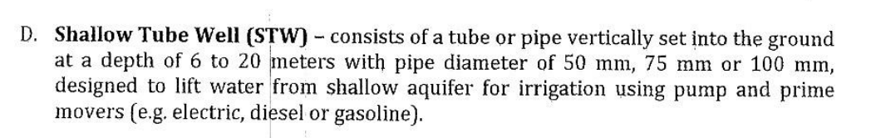
QUESTION 17
This refers to a system consisting of a tube of pipe that is vertically set on the ground and is designed to lift water from shallow aquifer for irrigation using pump and other prime movers.
Shallow tubewell
Deep well
Aquifer well
Perched well
Reference: https://www.da.gov.ph/wp-content/uploads/2018/07/mo19_s2018.pdf
ATTRTC ABELE Review 2024
ATTRC ABELE Review 2025
Irrigation and Drainage Engineering | Groundwater Hydrology
Irrigation and Drainage Engineering | Groundwater Hydrology

Slide 39
QUESTION 18
According to PAES 615:2016, there are four types of shallow well. Which type is used in unconsolidated formations with shallow water tables that contain not too many rocks?
Dug well
Bored/Augered well
Driven well
Jetted well
Reference: https://www.da.gov.ph/wp-content/uploads/2018/07/mo19_s2018.pdf
ATTRTC ABELE Review 2024
ATTRC ABELE Review 2025
Irrigation and Drainage Engineering | Groundwater Hydrology
Irrigation and Drainage Engineering | Groundwater Hydrology

Slide 40
Types of Shallow Well
Dug well - used in unconsolidated formations with large diameters which permit considerable water storage.
Bored/Augered well - used in formations with very shallow water depths
Driven well - used in unconsolidated formations with shallow water tables that contain not too many rocks
Jetted well - constructed by the cutting action of a downward-directed steam of water to excavate the hole and carry the excavated materials out of the hole.
Reference: https://www.da.gov.ph/wp-content/uploads/2018/07/mo19_s2018.pdf
ATTRTC ABELE Review 2024
ATTRC ABELE Review 2025
Irrigation and Drainage Engineering | Groundwater Hydrology
Irrigation and Drainage Engineering | Groundwater Hydrology

Slide 41
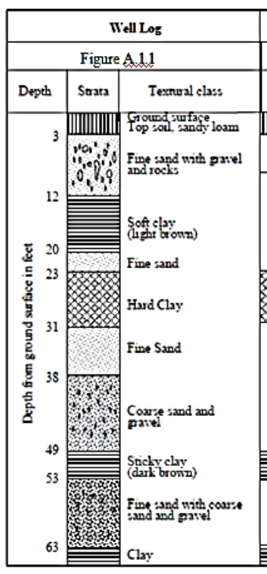
QUESTION 19
(PNS/BAFS/PAES 231:2017) This refers to a record of formation stratification of an aquifer showing the depth, thickness, lithology and other aquifer physical characteristics
Strata
Aquifer log
Well log
Well profile
Reference: (PNS/BAFS/PAES 231:2017)
ATTRTC ABELE Review 2024
ATTRC ABELE Review 2025
Irrigation and Drainage Engineering | Groundwater Hydrology
Irrigation and Drainage Engineering | Groundwater Hydrology

Slide 42
QUESTION 20
(PNS/BAFS/PAES 231:2017) Which of the following lists all important aquifer properties to be considered in well design, drilling and development, and in selection of pumping units?
Lithological properties, soil properties, hydraulic properties, and recharge-discharge properties
Lithological properties, water properties, hydraulic properties, and recharge-discharge properties
Lithological properties, soil water properties, geologic properties, and recharge-discharge properties
Lithological properties, soil water properties, hydraulic properties, and recharge-discharge properties
Reference: (PNS/BAFS/PAES 231:2017)
ATTRTC ABELE Review 2024
ATTRC ABELE Review 2025
Irrigation and Drainage Engineering | Groundwater Hydrology
Irrigation and Drainage Engineering | Groundwater Hydrology

Slide 43
QUESTION 21
(PNS/BAFS/PAES 231:2017) Which of the following are the recharge-discharge properties of an aquifer?
Probable recharge, usable recharge, groundwater discharge, safe yield
Probable discharge, usable discharge, groundwater discharge, safe yield
Probable recharge, usable discharge, groundwater discharge, safe retention
Probable discharge, usable discharge, groundwater discharge, safe retention
Reference: https://www.da.gov.ph/wp-content/uploads/2018/07/mo19_s2018.pdf
ATTRTC ABELE Review 2024
ATTRC ABELE Review 2025
Irrigation and Drainage Engineering | Groundwater Hydrology
Irrigation and Drainage Engineering | Groundwater Hydrology

Slide 44
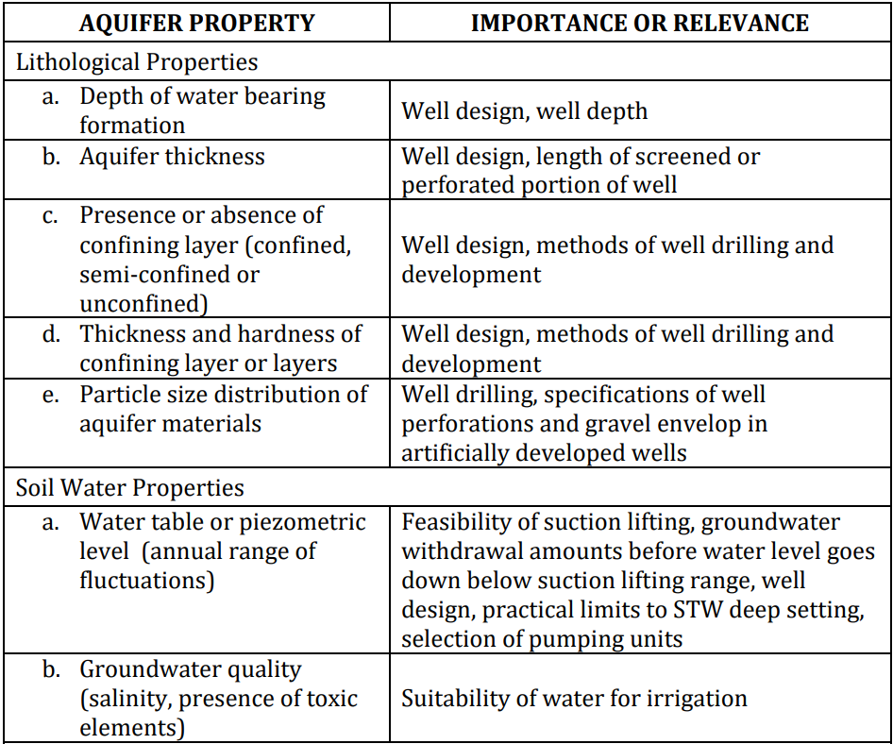
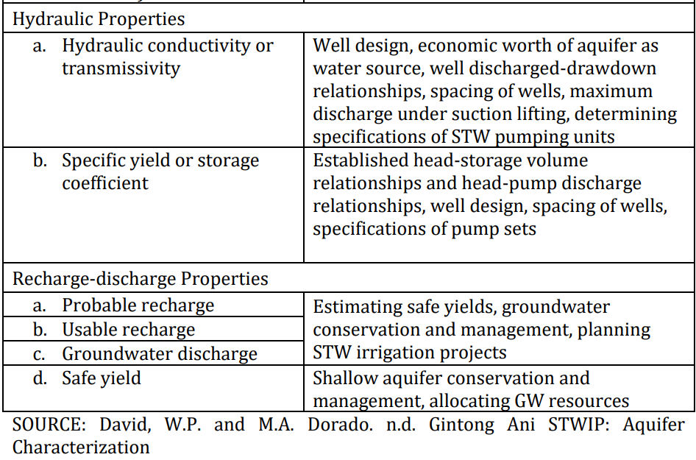
Reference: (PNS/BAFS/PAES 231:2017)
ATTRTC ABELE Review 2024
ATTRC ABELE Review 2025
Irrigation and Drainage Engineering | Groundwater Hydrology
Irrigation and Drainage Engineering | Groundwater Hydrology

Slide 45
Subsurface Flow to Drains
In subsurface drainage, field drains are used to control the depth of the watertable and the level of salinity in the rootzone by evacuating excess groundwater.
Steady-State Flow to Drains - that the drain discharge equals the recharge to the groundwater, and hence, the water table does not change with time. It only describes a simplified, constant relationship between the water table and the drain discharge.
Hooghoudt Equation
Ernst Equation
Unsteady-State Flow to Drains – considers that the recharge to groundwater varies with time and hence the flow of groundwater towards the drains is not steady.
Reference: https://edepot.wur.nl/183103
ATTRTC ABELE Review 2024
ATTRC ABELE Review 2025
Irrigation and Drainage Engineering | Groundwater Hydrology
Irrigation and Drainage Engineering | Groundwater Hydrology

Slide 46
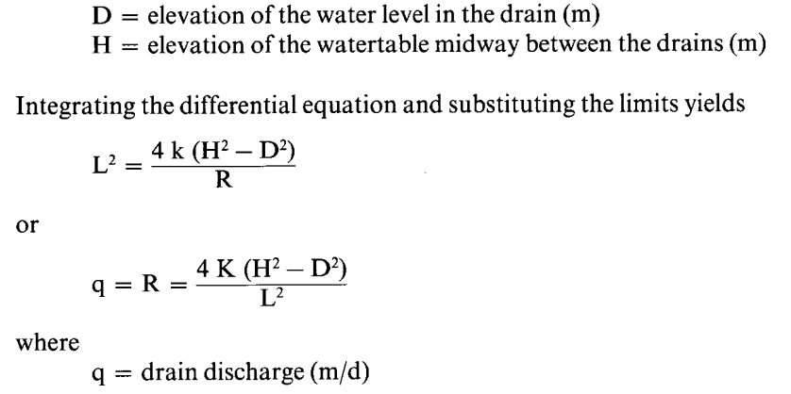
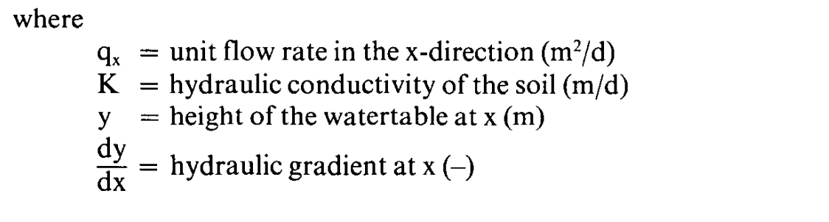
Hooghoudt Equation
The Hooghoudt Equation can be applied for a homogeneous soil profile or for a two-layered soil profile provided that the interface between the two layers coincides with the drain level.
Reference: https://edepot.wur.nl/183103
ATTRTC ABELE Review 2024
ATTRC ABELE Review 2025
Irrigation and Drainage Engineering | Groundwater Hydrology
Irrigation and Drainage Engineering | Groundwater Hydrology

Slide 47
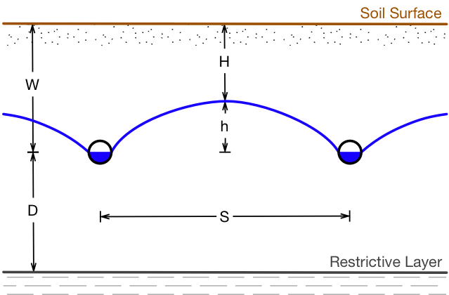
Hooghoudt Equation
The Hooghoudt Equation can be applied for a homogeneous soil profile or for a two-layered soil profile provided that the interface between the two layers coincides with the drain level.
Depth to Impervious Layer
H
L
Impervious Layer
Reference: https://edepot.wur.nl/183103
ATTRTC ABELE Review 2024
ATTRC ABELE Review 2025
Irrigation and Drainage Engineering | Groundwater Hydrology
Irrigation and Drainage Engineering | Groundwater Hydrology

Slide 48
ADDITIONAL QUESTION
In an attempt to the groundwater flow of a certain farm, two parallel canals have to be constructed. It was observed that the impervious layer exist at a depth of 1.9 m below the soil surface and the soil has a k value of 1.2 m/day. If the water table has to be maintained at a depth of 0.8 m below the soil surface, what will be the spacing of the drain when the drain level is 1.5 m below the soil. Assume a steady recharge of 2 mm/day.
Ans. 50.2m
h₂ = 1.5m
h₁ = 0.8m
Depth to Impervious Layer
k = 1.2m/day
R = 2mm/day
d = 1.9m
H
L
Impervious Layer
ATTRTC ABELE Review 2024
ATTRC ABELE Review 2025
Irrigation and Drainage Engineering | Groundwater Hydrology
Irrigation and Drainage Engineering | Groundwater Hydrology

Slide 49
ADDITIONAL QUESTION
An agricultural land is to be drained using tile drain system. The depth to impervious layer is 3.0 m and the depth to water table to be maintained is 0.6 m. The saturated hydraulic conductivity is 62.5 mm/hr and the drainage coefficient is 7 mm/day. If the drains will be installed 1.0 m below the ground surface, the drain spacing should be?
Ans. 38.84m
h₂ = 1.0m
h₁ = 0.6m
Depth to Impervious Layer
k = 62.5mm/hr
R = 7mm/day
d = 3.0m
H
L
Impervious Layer
ATTRTC ABELE Review 2024
ATTRC ABELE Review 2025
Irrigation and Drainage Engineering | Groundwater Hydrology
Irrigation and Drainage Engineering | Groundwater Hydrology

Slide 50
THANK YOU
ABELE | 2025
ATTRTC - Iligan City

